Slide 1









How Many Times We Get a Life ?

Slide 2










































D R E A M S
D R E A M S

Slide 3


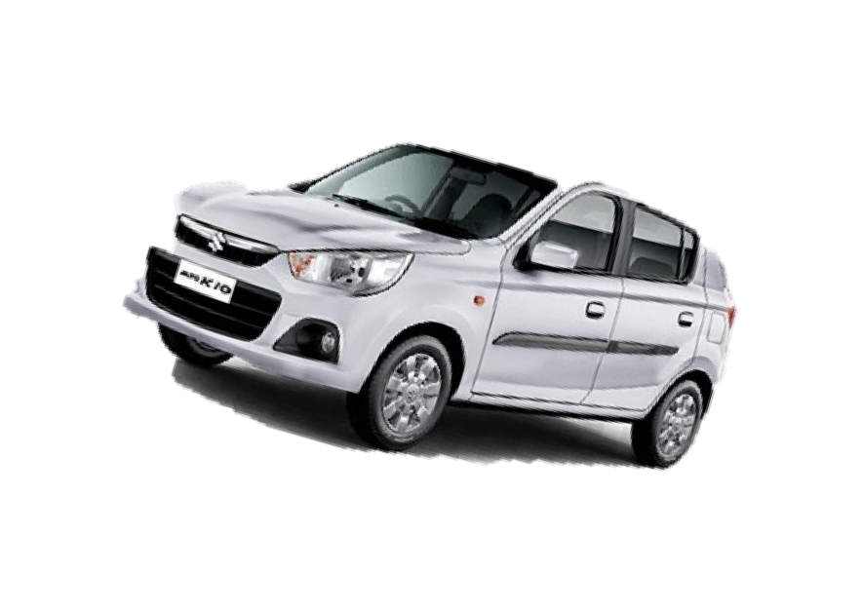

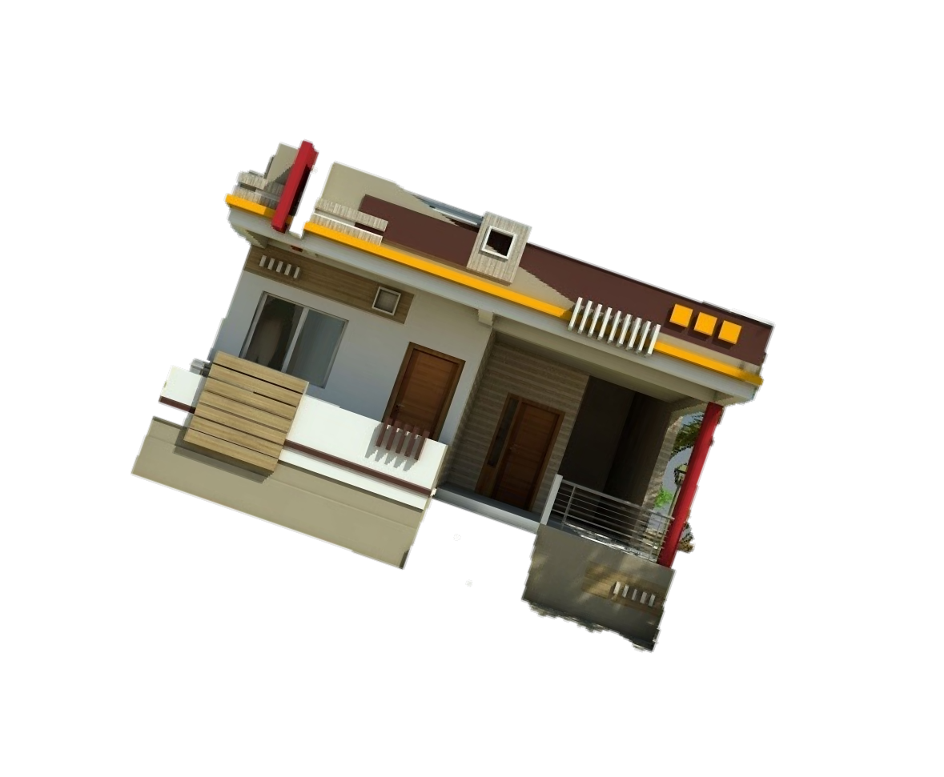




95 % POPULATION’S REALITY

Slide 4







ALSO 5% POPULATION’S REALITY

Slide 5

DO YOU HAVE A
DREAMS ?
DO YOU WANT TO FULLFIL THEM AT ANY
COST ?

Slide 6






WELCOME TO
LIFE CHANGE OPPORTUNITY

Slide 7




WELCOME TO
WE IMMORTALIZE YOUR MEMORIES

Slide 8
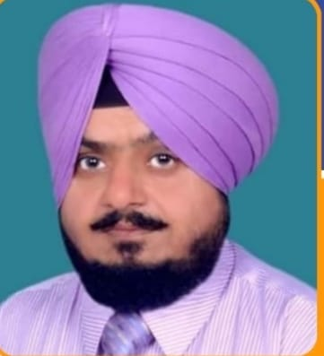
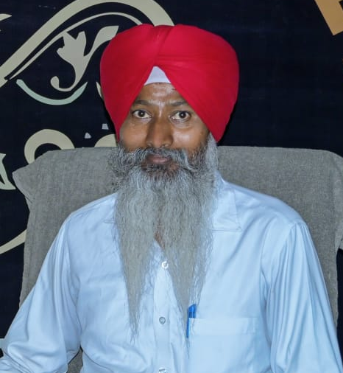
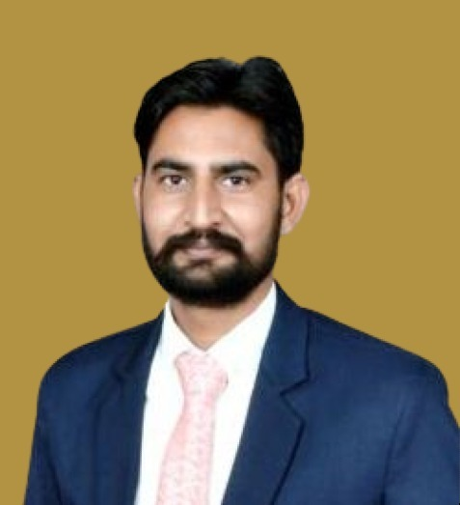
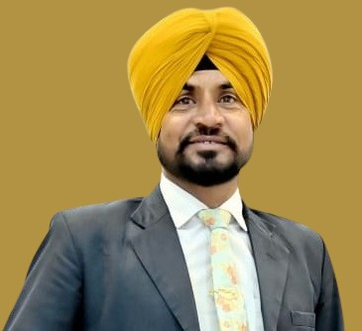

Sukhpal Singh
(MD)
Qualification : Post Graduation
Experience:
5 Years experience in music industry as a Company owner.
8 Years Teacher experience in own school.
26 Years experience in Direct Selling.
Running Project:
Shaheed Bhagat Singh Public School,
Gobindpura, Bathinda, Punjab.
Avtar Singh
(Director Operation)
Rashpinder Singh
(Director Services)
Gurpiyar Singh
(Director Public
Relation)
Sandeep Singh
(Director Sales)

Slide 9
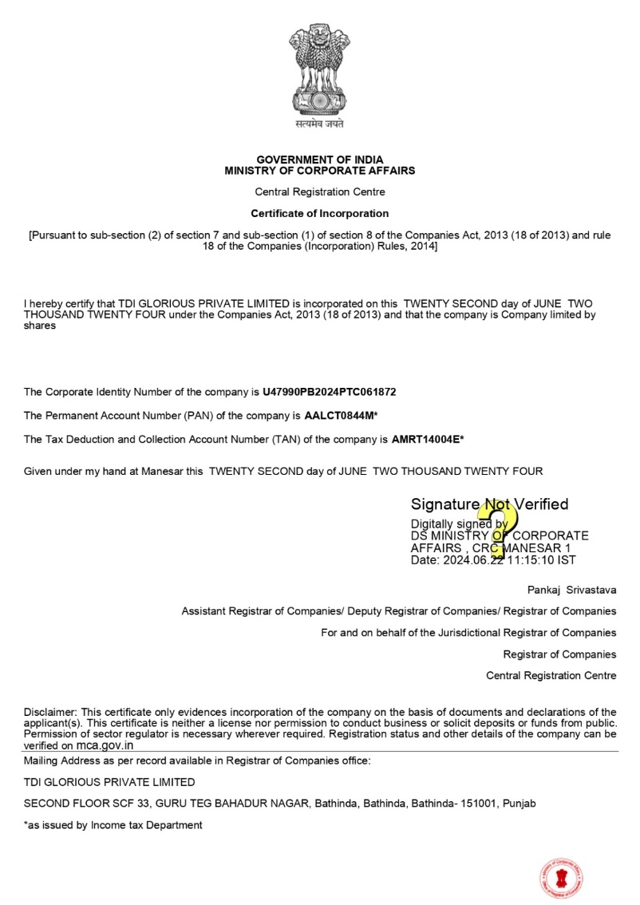
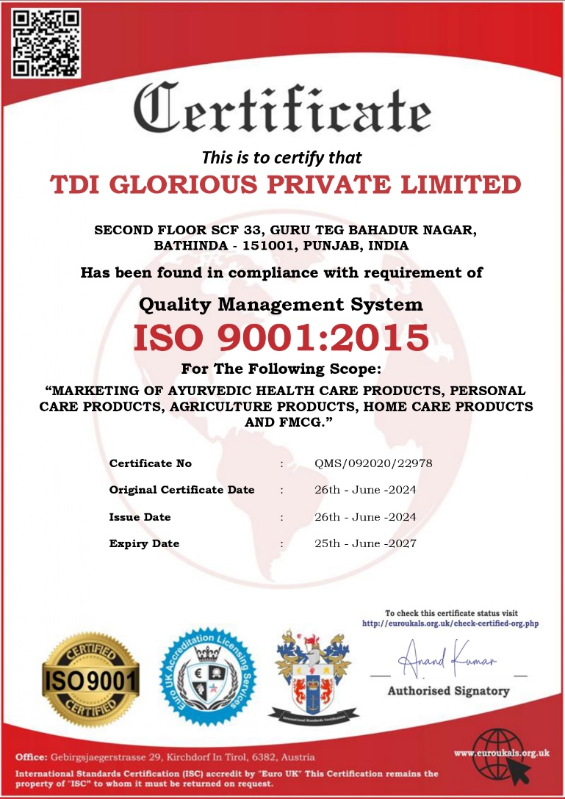

Slide 10
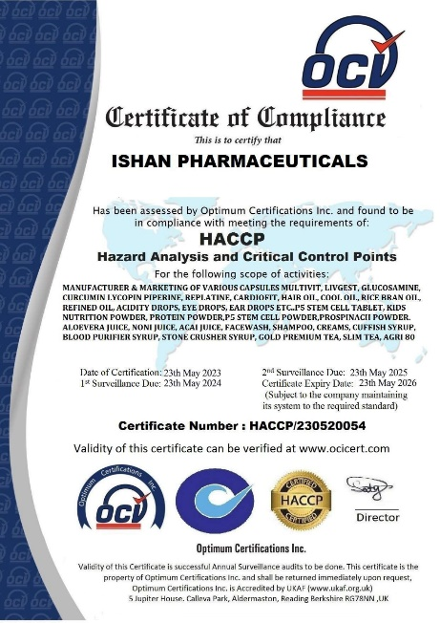
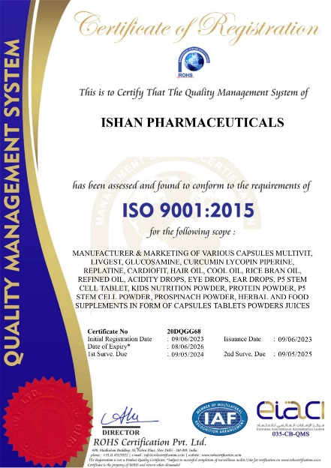
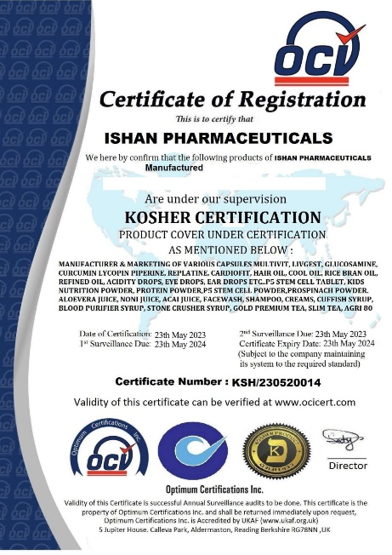
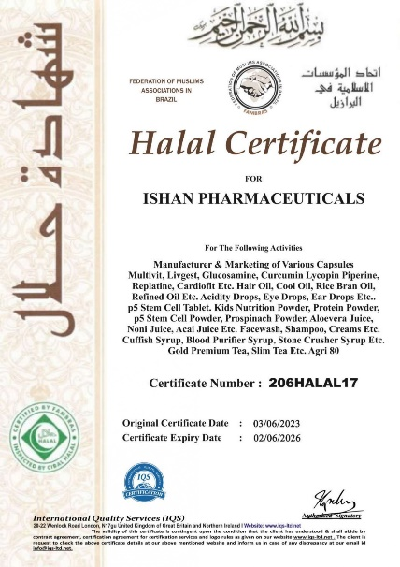
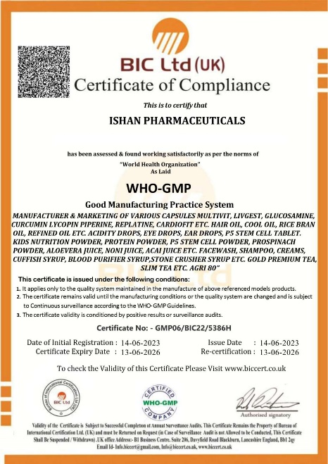
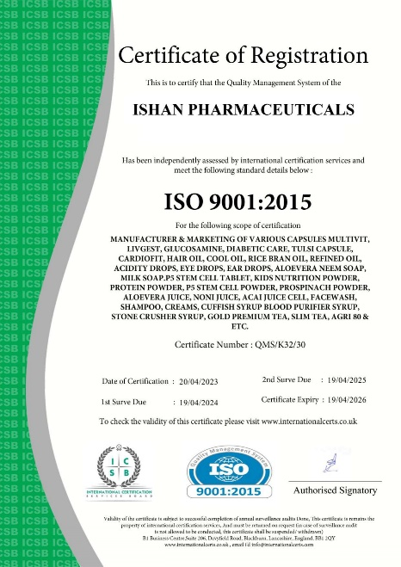
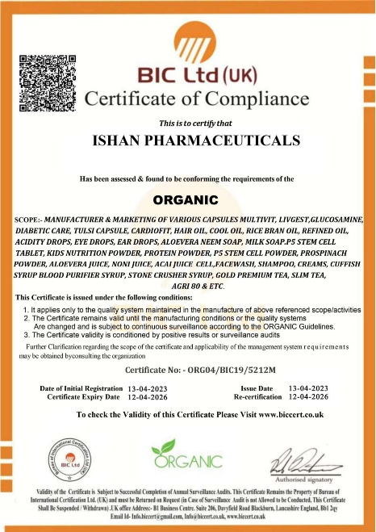
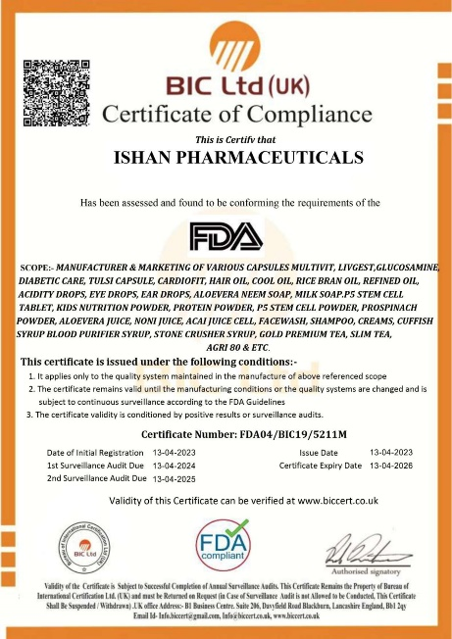

Slide 11
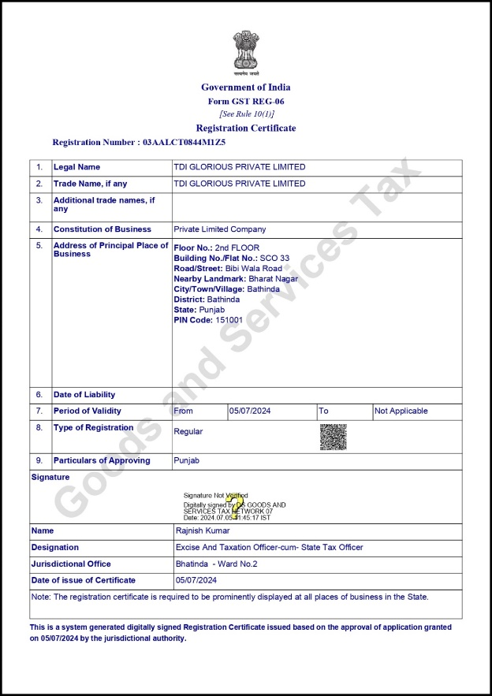
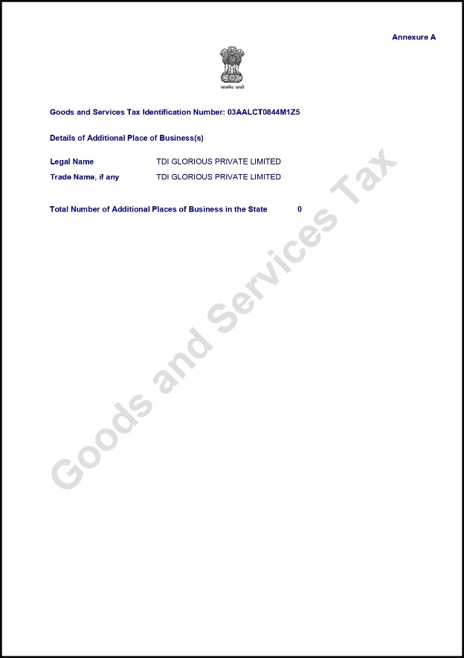
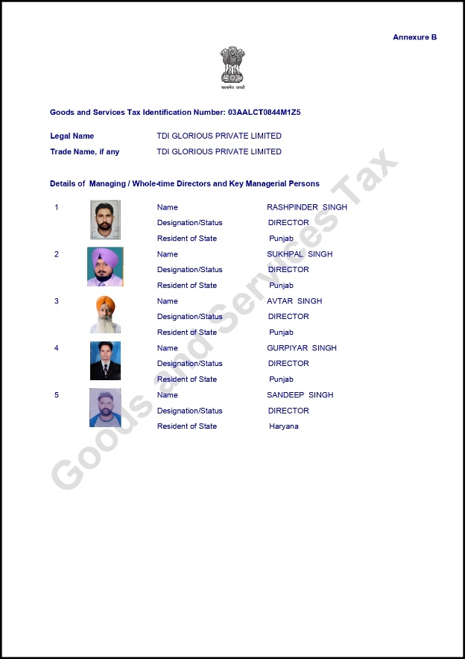

Slide 12
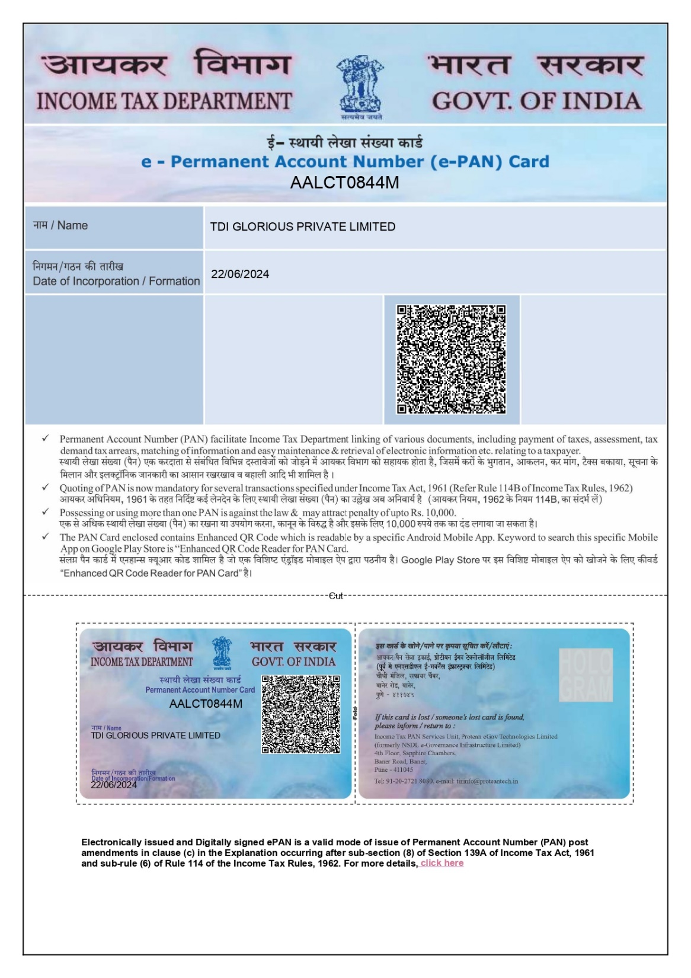

Slide 13
TERMS
Closing
Payout
Capping
Reward Closing
Daily Basis
Daily Basis 50000/-Daily Weekly

Slide 14


INCOMES
RETAIL BONUS
DIRECT SPONSOR
TEAM TURNOVER BONUS
LEVEL INCOME
DEVELOPMENT INCENTIVE
REWARD
ROYALTY
DOMESTIC TOUR
RETREAT PROGRAMS
INTERNATIONAL TOURS

Slide 15



PACKAGES
PERSON PURCHASE PRODUCTS OF 40 PP
40 PP
DP OF 40DPP (HEALTH PRODUCTS) UPTO RS 4000/-
PERSON PURCHASE PRODUCTS OF 40 PP
DP OF 40PP (PERSONAL CARE AND OTHERS) UPTO RS 4500/-
MEANING OF PP - PURCHASE POINTS

Slide 16









ACTIVATION
PACKAGE ACTIVATE
40 PP

Slide 17


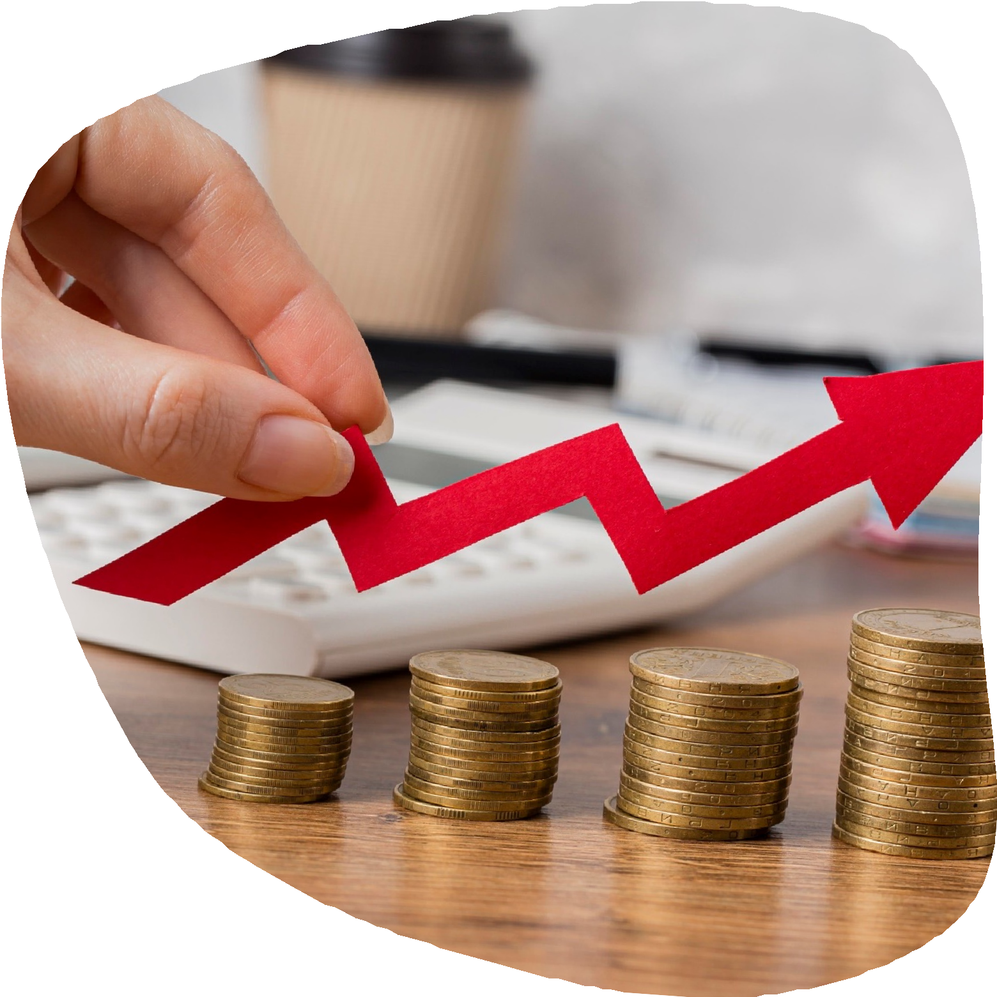


PROFIT
RETAIL INCOME
UP TO 25% INCOME
ON SALE

Slide 18



B I N A R Y
ON EACH BINARY YOU WILL GET 15% ON PP

Slide 19






RANK
REWARD
RANK
ON TEAM PP & SELF PP
COMMISSION
INCOME

Slide 20


INCOME
DIRECT
SPONSER
200/- INR

Slide 21


LEVEL
INCOME
LEVEL | INCOME
₂nd | 150
3rd | 150

Slide 22

1ST RANK(ASSOCIATE)
40 PP
YOU
40PP
40PP
Direct Sponsor Income ------- 200/-
Direct Sponsor Income ------- 200/-
Matching Bonus ------- 300/-
TD Incentive 1Product (2000/-)
Total Income - 2700/-

Slide 23
2nd RANK(STAR)
40 PP
YOU
100PP
100PP
Direct Sponsor Income ------- 900/-
Total Matching Bonus ------- 900/-
TD Incentive 2Products (4000/-)
Total Income - 5800/-

Slide 24
3RD RANK(DOUBLE STAR)
40 PP
YOU
250PP
250PP
Direct Sponsor Income ------- 2100/-
Total Matching Bonus ------- 2100/-
Kit Bag + Tools ------ 3000/-
Total Income - 7200/-

Slide 25




RANK REWARDS AWARDS

Slide 26

TDI MASTER TABLE
Sr. | Self PP+Rep. | Team Matching PP | Rank | Rank Bonus | TEAM TURNOVER BONUS | DIRECT INCENTIVE | Rewards
1 | 40 | 40 | ASSOCIATE | 2000 | 1 Product |  | -
2 | 40 | 100 | STAR | 4000 | 2 Product |  | -
3 | 40 | 250 | DOUBLE STAR | 3000 | - |  | -
4 | 40+10=50 | 500 | BRONZE STAR | 4000 | - |  | -
5 | 50 | 1000 | SILVER STAR | 5000 | - |  | -
6 | 50 | 2500 | GOLD STAR | 10000 | - |  | TAB
7 | 50 | 5000 | PLATINUM STAR | 30000 | - |  | SAMRT LED
8 | 50+25=75 | 10000 | RUBI STAR | 50000 | - |  | Laptop
9 | 75 | 25000 | PEARL STAR | 150000 | - |  | Bike
10 | 75 | 50000 | DIAMOND STAR | 300000 | -
11 | 75 | 100000 | DIRECTOR | 600000 | -
12 | 75+125=200 | 200000 | SENIOUS. DIRECTOR | 1000000 | - |  | FALT
13 | 200 | 400000 | BRONZE DIRECTOR | 2500000 | - |  | Luxury Car Payment
14 | 200 | 800000 | SILVER DIRECTOR | 5000000 |  |  | DUBAI Trip (3N-4D)
15 | 200 | 1600000 | GOLD DIRECTOR | 10000000 |  |  | EUROPE Trip (3N-4D)
16 | 200 | 3200000 | PLATINUM DIRECTOR | 30000000 |  |  | Bungalow
17 | 200 | 6400000 | RUBI DIRECTOR | 50000000 |  |  | EUROP Trip (3N-4D)
Kit Bags + Tools
Dress Code + Tie
Smart Watch
Car Down Payment
Car Full Payment

Slide 27







RETREAT PROGRAM

Slide 28





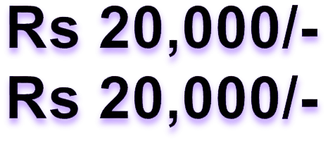

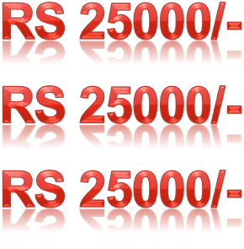

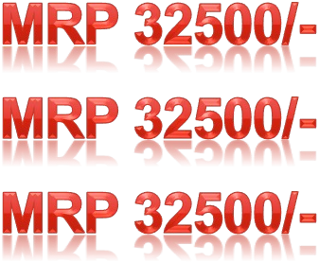
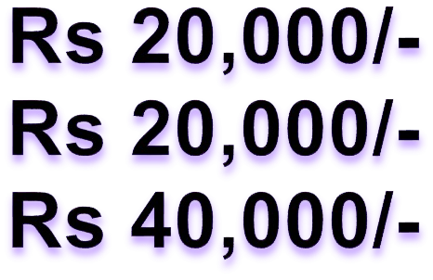









TDI SALE CENTER

Slide 29



